Slide 1
Towards an Anti-oppression museum manifesto
nikhil trivedi
Senior Systems Analyst, Art Institute of Chicago
@nikhiltri | nikhiltrivedi.com

Slide 2
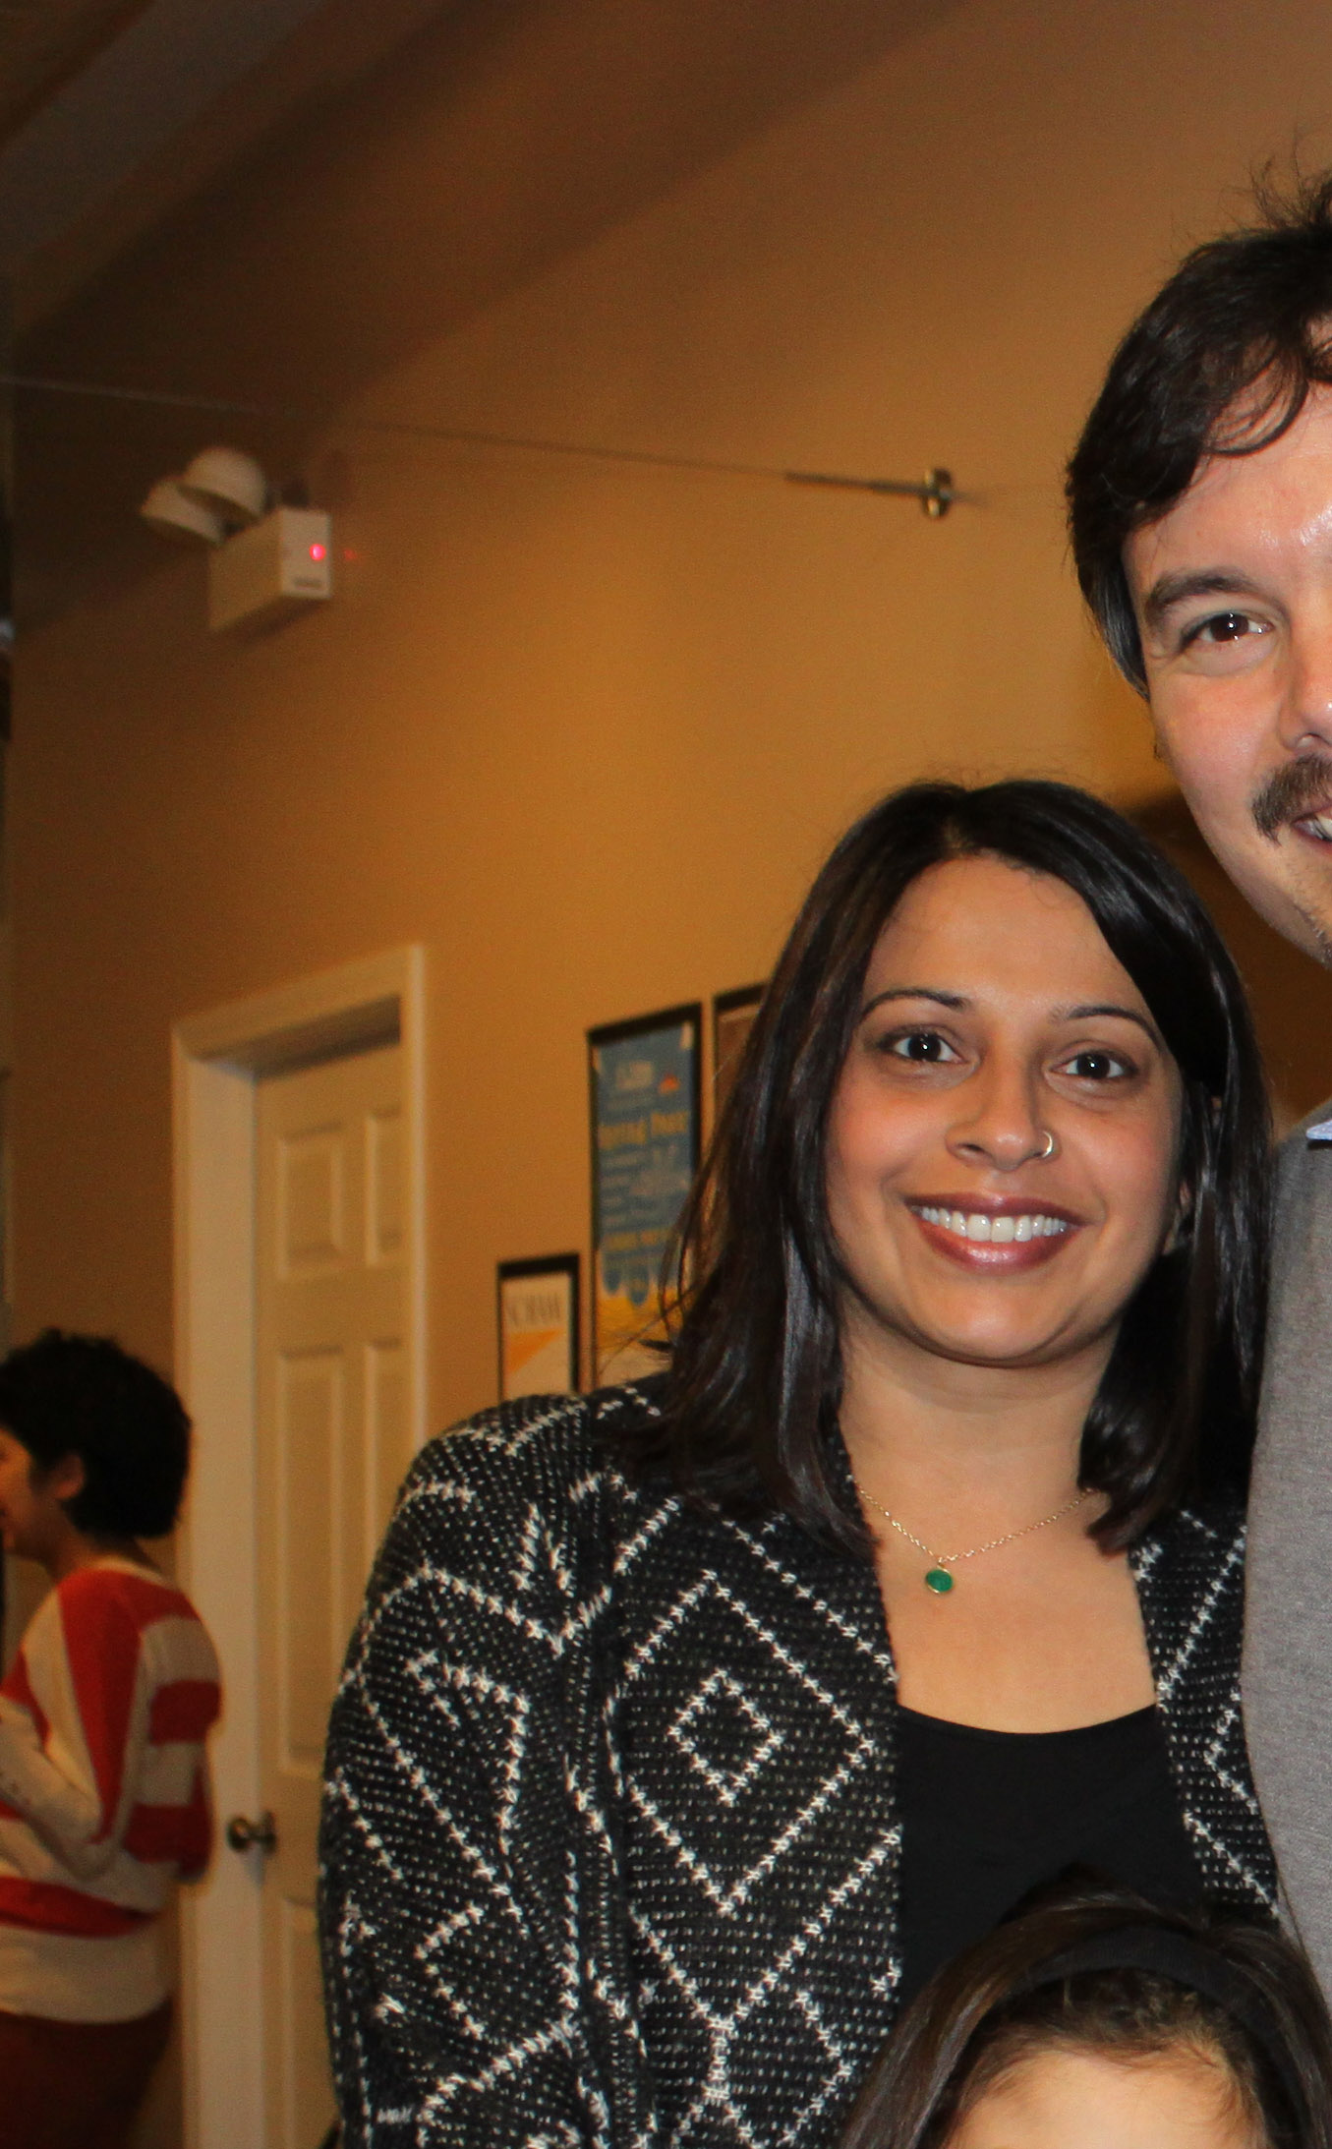
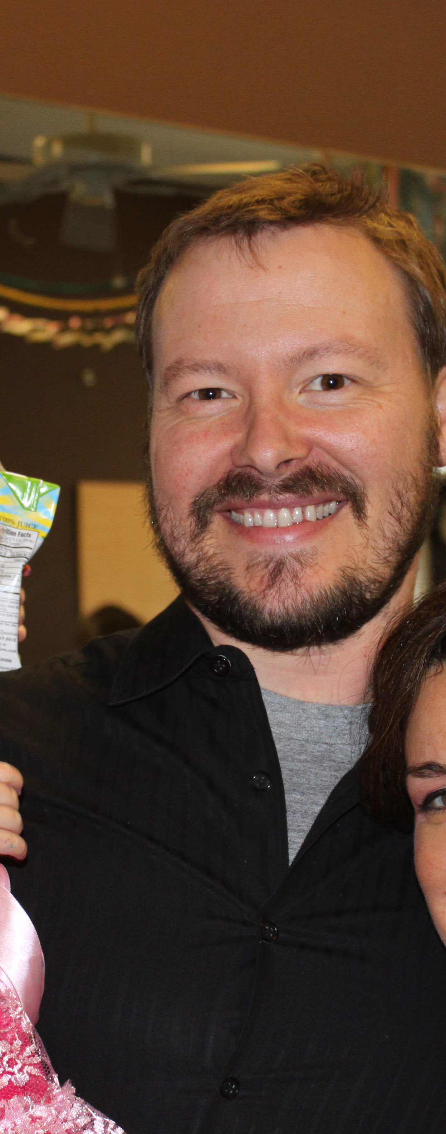
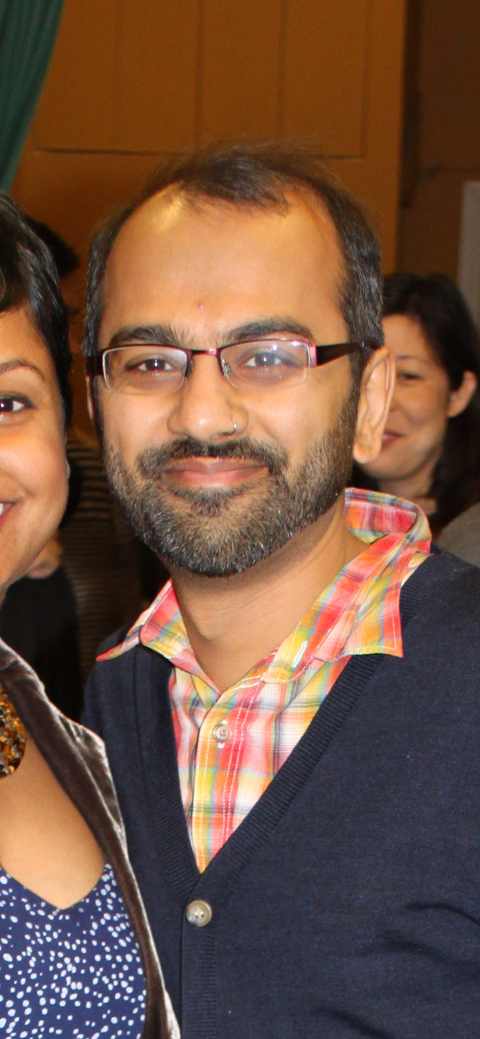
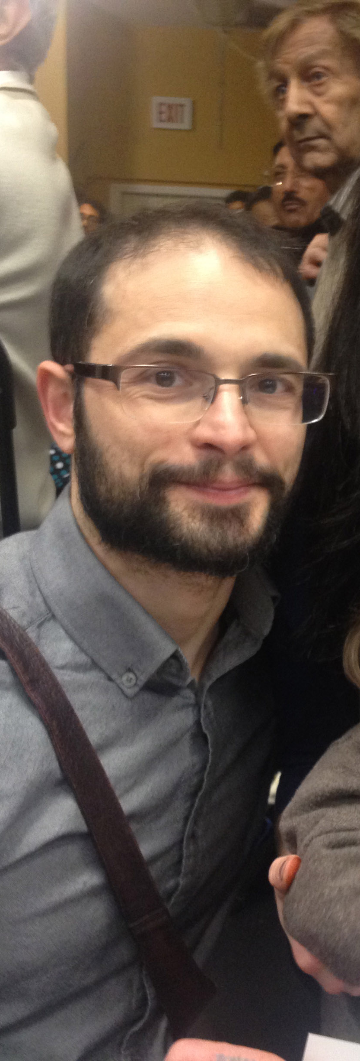
This is your first slide.
(Notice the little 15-second timer at the bottom. You don’t have to keep it there if you don’t want to.)
Notes:
I live two lives.

Slide 3
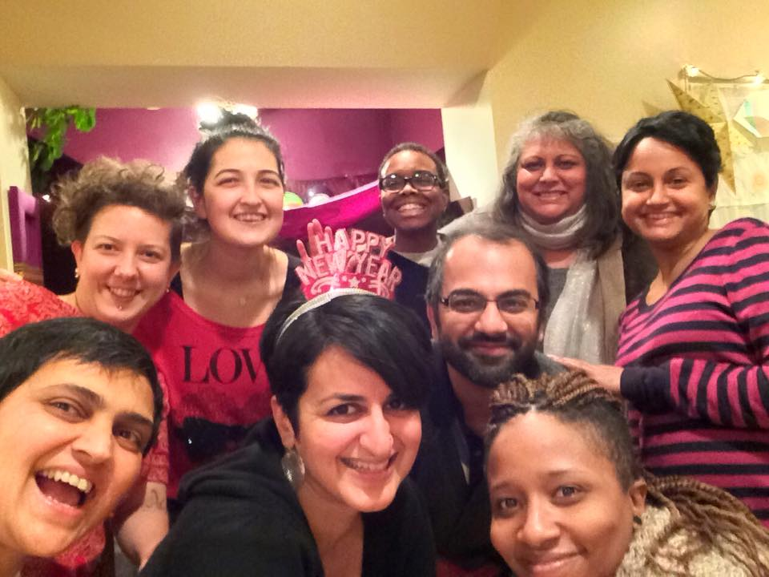
This is your second slide.
(And so on.)
Notes:
Outside of work

Slide 4
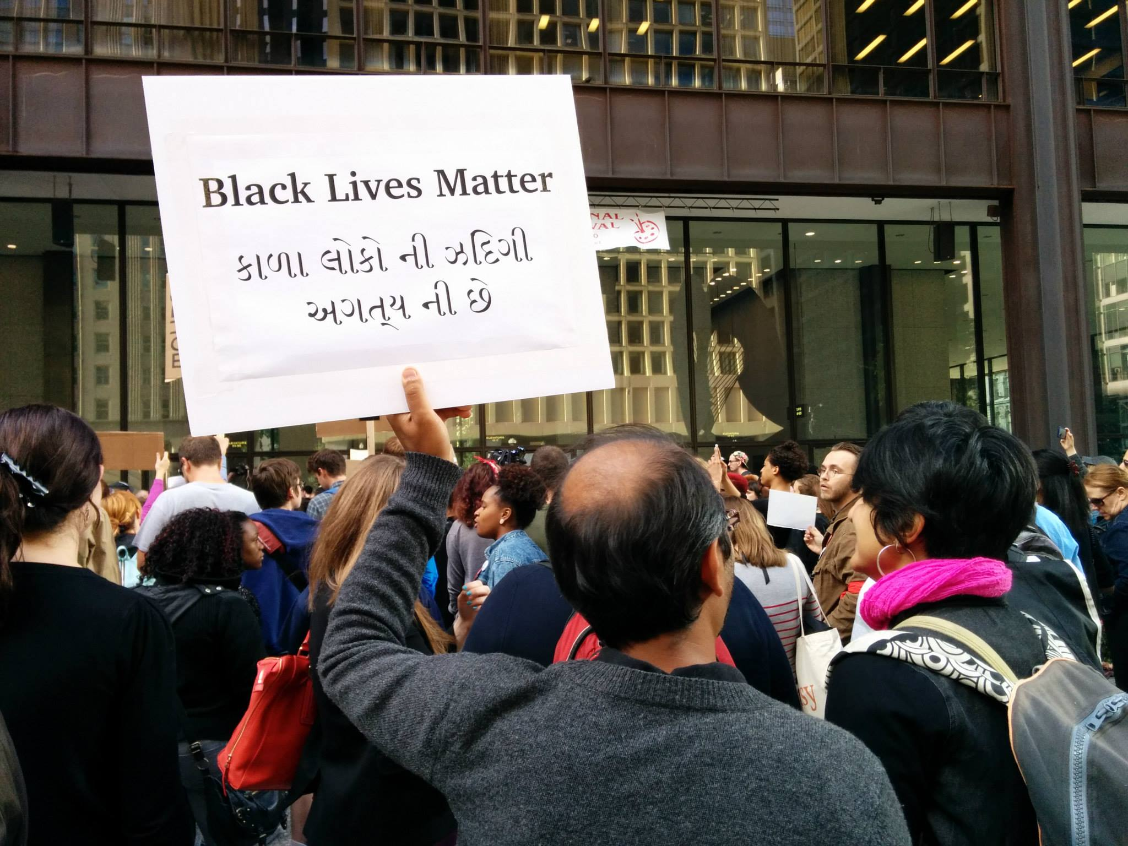
Photo by Kelly Hayes, transformativespaces.org, @bullhorngirl
Notes:
We fight for a more just world

Slide 5
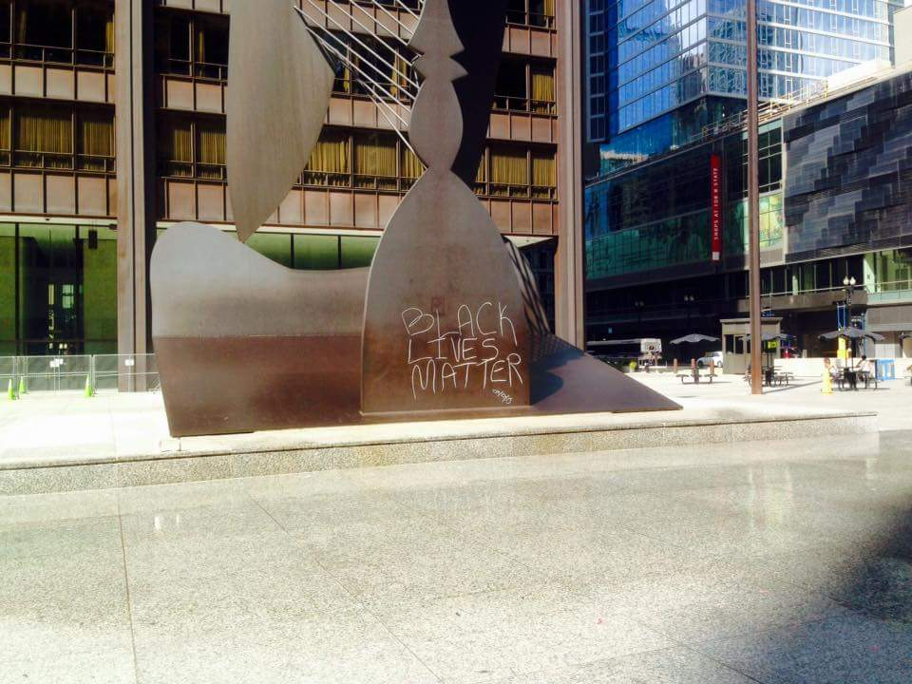
Photo by Timothy Bradford
Notes:
I don’t want these two worlds to remain separate

Slide 6
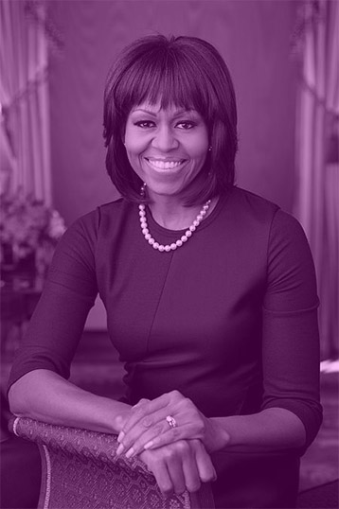
“There are so many kids in this country who… think to themselves, well, that’s not a place for me, for someone who looks like me.”
Michelle Obama, First Lady of the United States of America
Notes:
Our spaces are alienating for many of the people I’m close to.

Slide 7
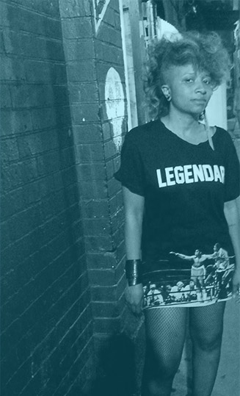
“I observe how youth of color are treated in the space, because it affects whether or not I view it as welcoming of part of my community.”
Shonettia Monique, Healing Justice Activist
Notes:
As a result, our institutions will change.

Slide 8
Photo by M.Belickis, etsy.com/shop/ModernGirlBlitz
Notes:
But let’s first talk about what an anti-oppression framework is.

Slide 9
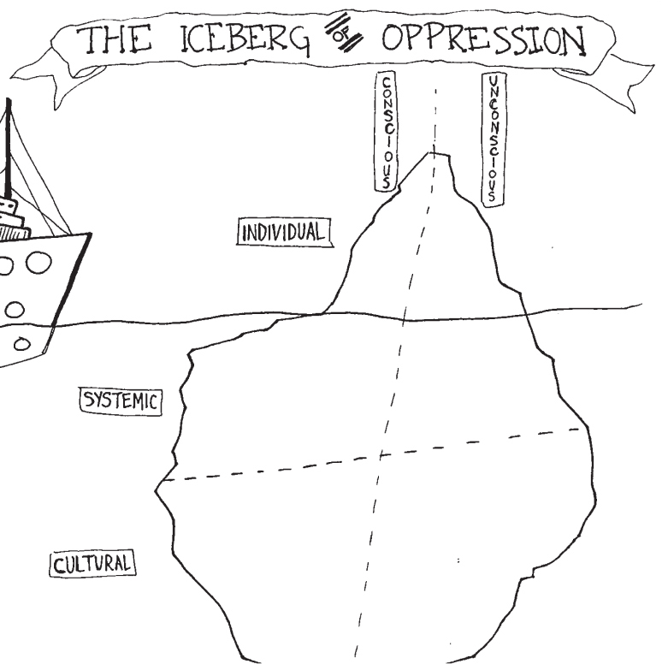
AORTA Collective's Iceberg of Oppression
Notes:
For example, as a man I benefit from male supremacy,

Slide 10
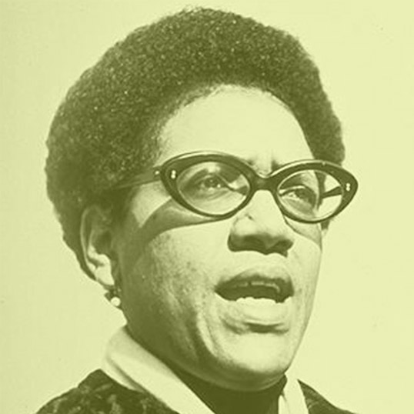
“There is no such thing as a single-issue struggle because we do not live single-issue lives.”
Audre Lorde
Notes:
This framework examines and addresses everything from…

Slide 11
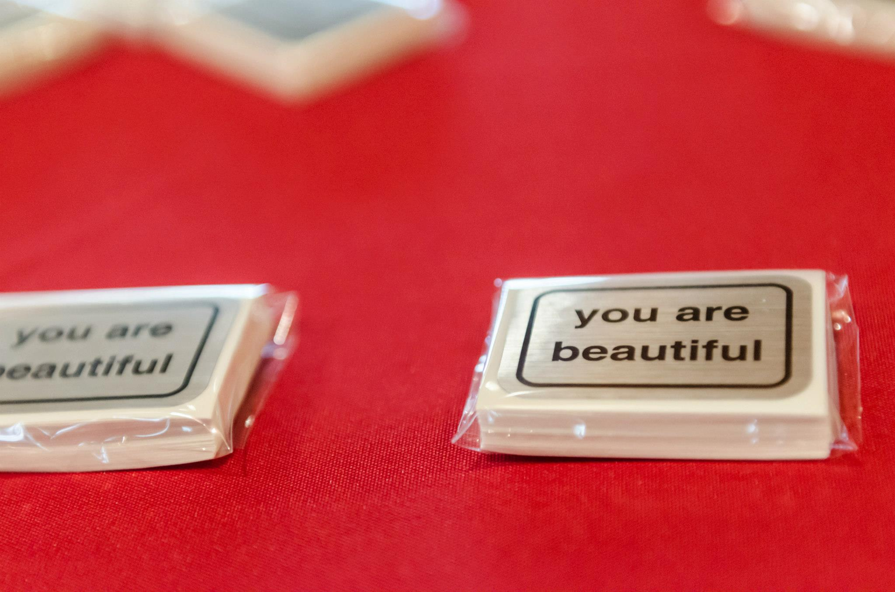
Photo by Sarah-Ji, loveandstrugglephotos.com
Notes:
This is work that we do with love, compassion and care.

Slide 12
“I love museums that respectfully hold a space for me to see aspects of myself, my history, my people without feeling like a museum piece, myself.”
Tanuja Jagernauth, Prison Abolitionist, Artist, Healing Justice Organizer
Notes:
There’s work like this already happening in our field.

Slide 13
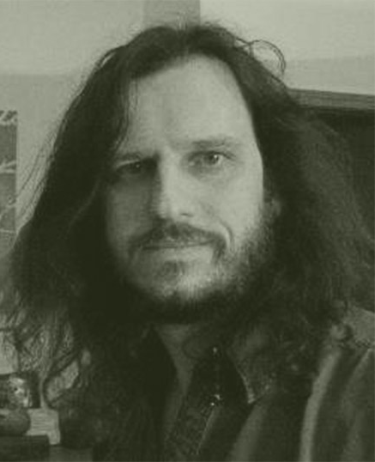
“There’s more value in how we wonder about things than what we know about them.”
Jim McDonald, Herbalist
Notes:
For us in museum technology,

Slide 14
Photo by Sarah-Ji, loveandstrugglephotos.com
Notes:
Whose HISTORIES do we value?

Slide 15
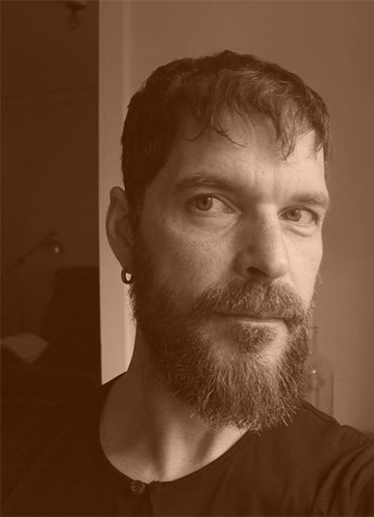
“We are only here tonight because some time ago, someone collected something.”
Tim Svenonius, IgniteMCN 2013
Notes:
As educational institutions,

Slide 16
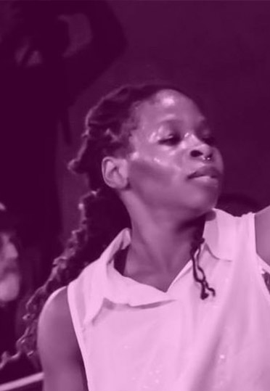
“It is difficult to be in some museum exhibits and not connect their ‘artifacts’ to colonialism, genocide, rape, and murder.”
Ni’Ja Whitson, Queer Interdisciplinary Artist, Activist
Notes:
Finally, who gets to be REPRESENTED by their own, fully empowered choice?

Slide 17
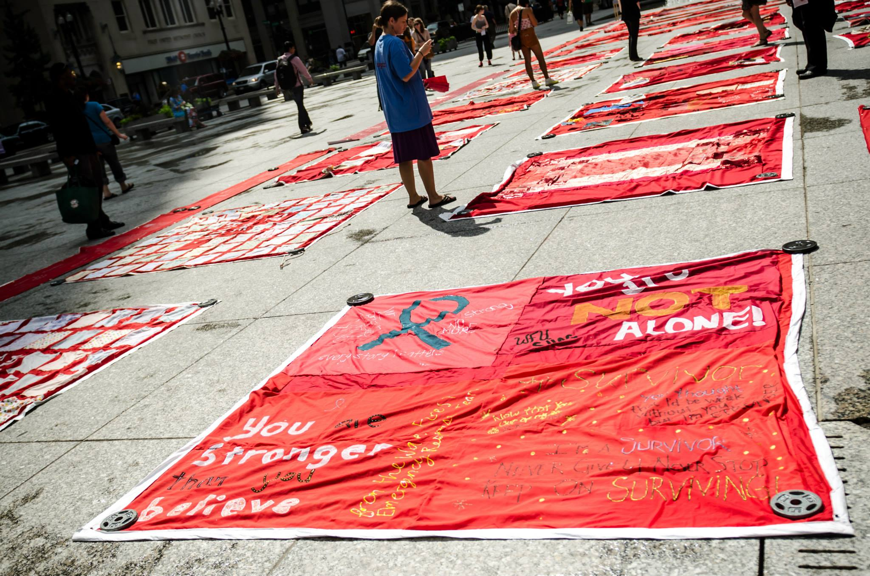
Photo by Sarah-Ji, loveandstrugglephotos.com
Notes:
This is complicated work that requires time, effort and commitment.

Slide 18
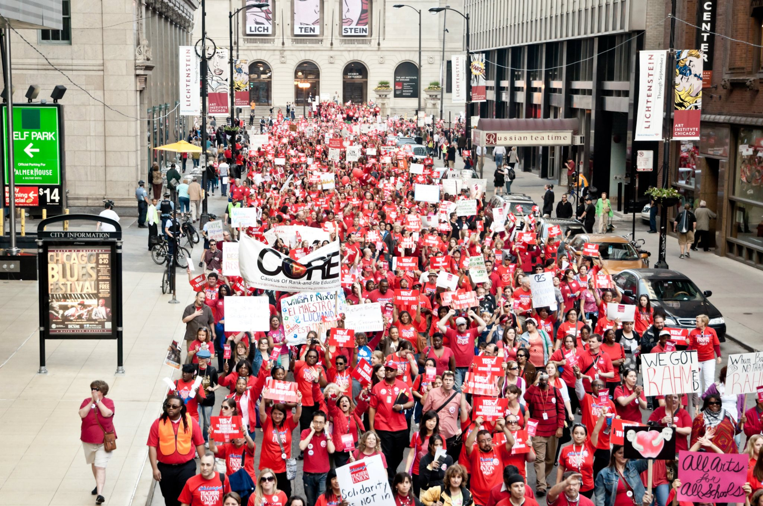
Photo by Sarah-Ji, loveandstrugglephotos.com
Notes:
I leave you with two calls to action:

Slide 19
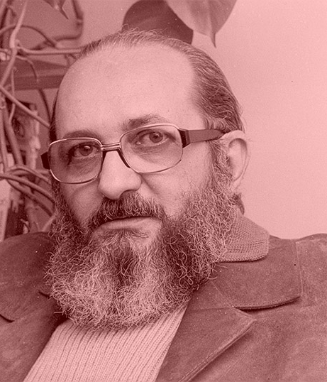
“Reflection + Action = Change”
Paulo Freire
Notes:
Then, after MCN commit to a regular conversation

Slide 20
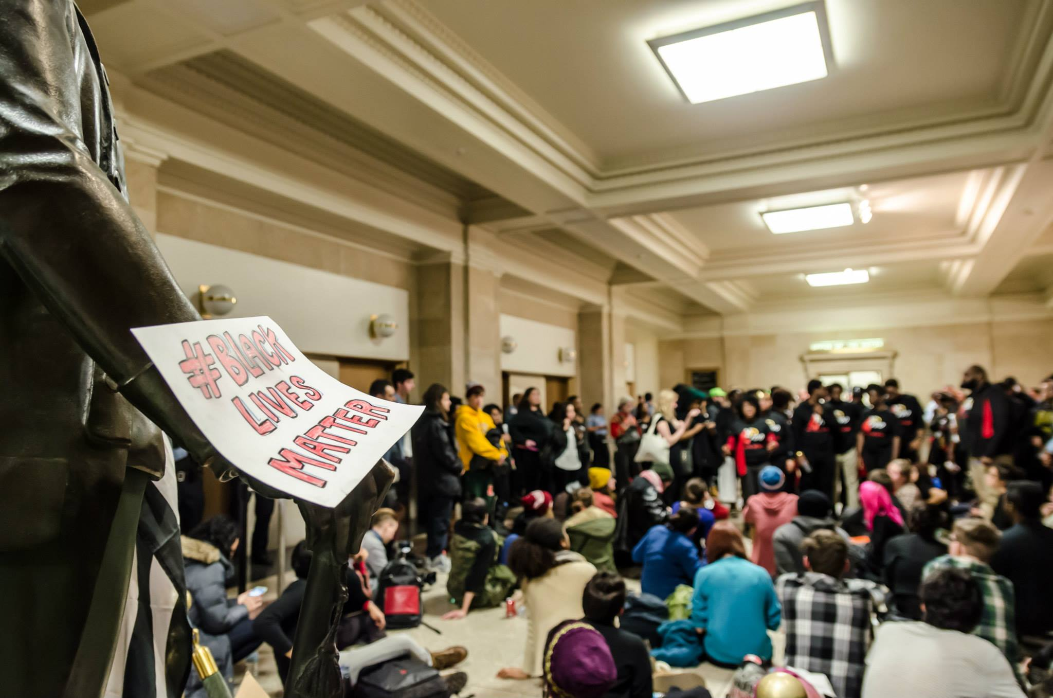
Photo by Sarah-Ji, loveandstrugglephotos.com
Notes:
That’s all I ask, and I know you can do this.

Slide 21
Thanks!
nikhil trivedi
Senior Systems Analyst, Art Institute of Chicago
@nikhiltri | nikhiltrivedi.com

